Slide 1


X86 Gem5 Checkpoint Generation with SimPoint
Abir Mojumder
CPRE 581
Instructor: Dr. Henry Duwe

Slide 2
Introduction
Accurate analysis of microarchitecture requires cycle-level, detailed simulation
Detailed Simulation takes a very long time – Weeks/Months
Benchmarking an architecture relies on executing several loops
How do you shorten this simulation time?
Analyze program behavior
Select portion that best represents the overall behavior/patterns
Execute only this portion
Benefit: Huge speedup, high accuracy

Slide 3
Motivation
Gem5 portions of the homeworks use checkpoints from SimPoint
Only 1 checkpoint is run for each benchmark program
Is this representative of the entire program?
How accurate are the CPI values we are measuring?
Learn the process of creating checkpoints in Gem5
Analyze how accurately the simulation points replicate the program’s behavior.
How much faster is it?

Slide 4
Related Work
Sampling Simulations: SimPoint paper[1] discusses finding intervals that closely relate via Basic Block Vectors. Using k-means algorithm for phase classification to sample regions of a program that behave similarly. Simulating these regions should in theory produce results that imitate the real program.
Quality of sample simulation is largely dependent on the starting state image. Fast-forwarding to an instruction vs generating checkpoints is discussed by Van Biesbrouck[2].
Cache warming method affects accuracy of simulation and is a topic for speed vs accuracy[3][4]. SimPoint and SMARTS methods have 3% and 0.64% error rates respectively. SimPoint is twice as fast as SMARTS.

Slide 5
Methodology
1. Selecting benchmarks and their data sets from SPEC2006 suite.
2. Generate BBV from each of the benchmark programs via Gem5.
3. Feed the BBV data into the SimPoint tool to get simulation points and their respective weights.
4. Re-run the benchmarks in Gem5 with the simulation points to capture sampling information (checkpoints).
5. Run benchmarks with the created checkpoints (Multiple checkpoint runs per program).
6. Compare the accuracy in terms of CPI, and the speedup in terms of real execution time.

Slide 6
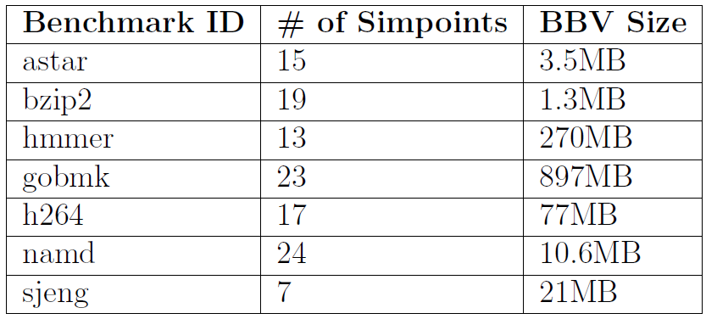
Tools Used for the Experiments
Gem5 v23.0.1.0
SimPoint 3.2
BBMatrix (python-based similarity matrix visualization)
SPEC2006 - astar, bzip2, gobmk, h264ref, hmmer, namd and sjeng

Slide 7
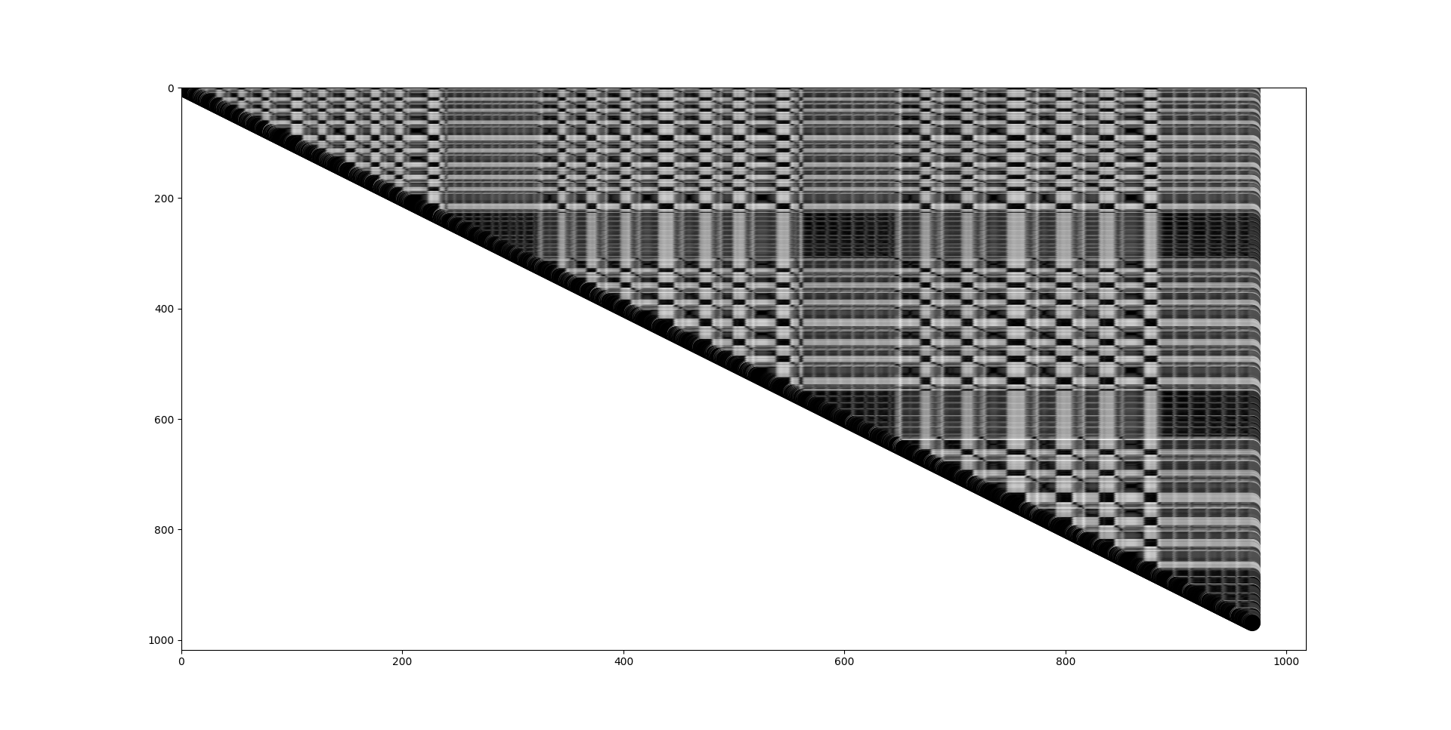
BBV Similarity Matrix
Bzip2 Similarity Matrix – Calculated with Manhattan Distance

Slide 8
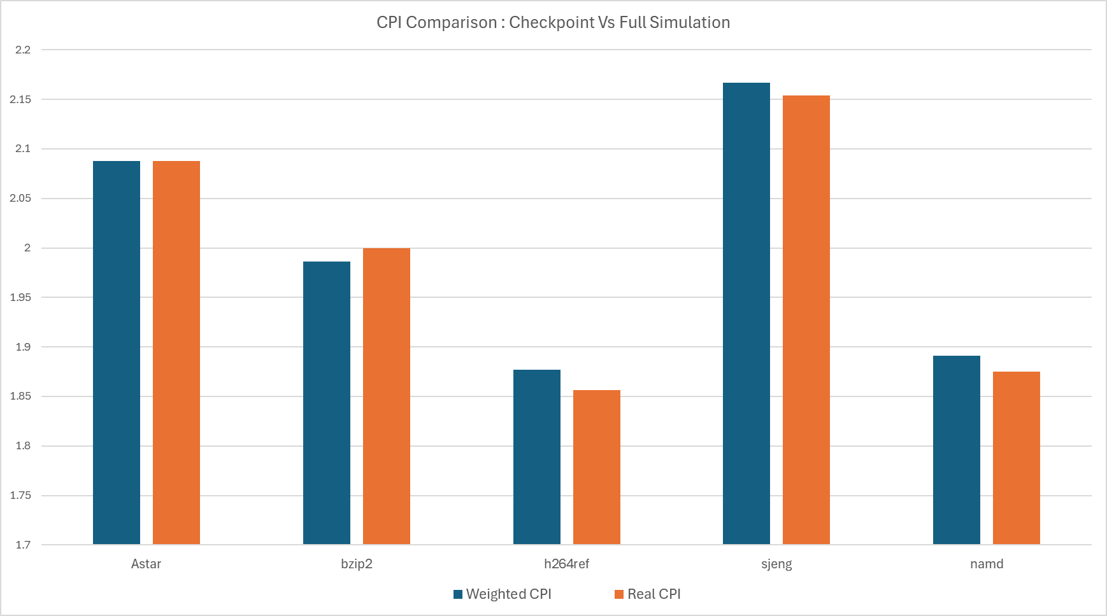
Results
CPI for simpoints are weighted. CPI = W1*CPI1 + W2*CPI2…
CPI is generally higher (slower).
Values are close enough to show that the checkpoints were created from representative samples.

Slide 9
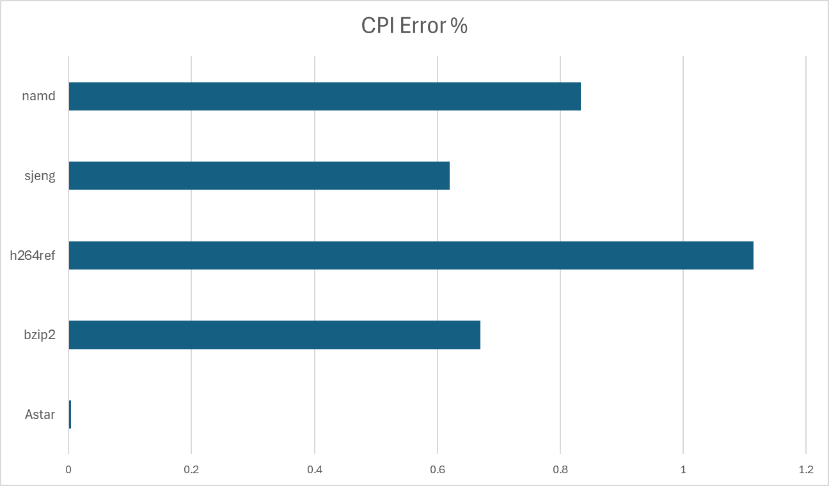
Results
Reference papers show that SimPoint CPI Error rate with reference data averages to 3%
Error rates in this experiment are far smaller with an average of 0.6% 2 Reasons:
Small subset of benchmarks
Test data much smaller than reference.

Slide 10
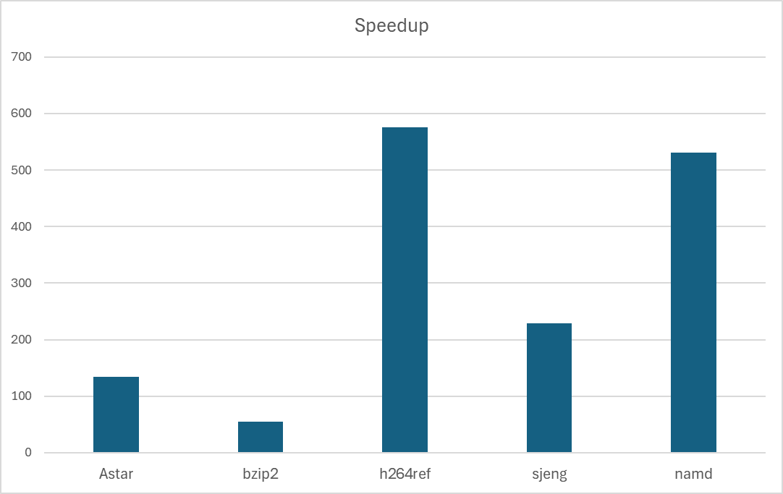
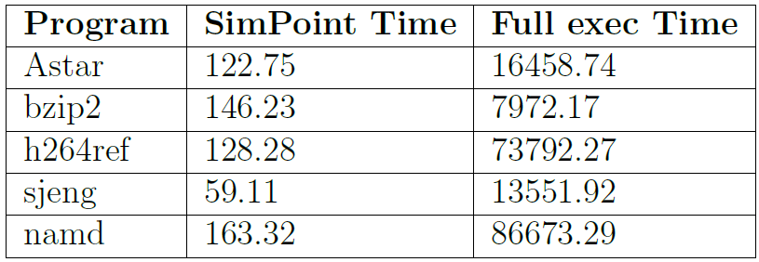
Results

Slide 11
Issues Faced
Some programs such as GCC and MCF kept crashing when other programs running at the same.
A few of the benchmarks stopped midway (after 3-4 days of simulation).
Some of the Fortran programs caused kernel panics.

Slide 12
Conclusion
Generating checkpoints in Gem5 is fairly straightforward, but very time consuming.
BBV + Checkpoint generation has huge time overhead (twice as long as a single full simulation)
Low error rates even with test inputs show that SimPoint sampling method is effective even with fewer patterns.
Speedup is largely dependent on number of checkpoints and their weights.
Future work to reduce some of the overheads; sampling method integration in simulators could save time.

Slide 13
References
[1] Sherwood, T., Perelman, E., Hamerly, G., and Calder, B. Automatically characterizing large scale program behavior. In Proceedings of the 10th International Conference on Architectural Support for Programming Languages and Operating Systems (New York, NY, USA, 2002), ASPLOS X, Association for Computing Machinery, p. 45–57.
[2] Van Biesbrouck, M., Calder, B., and Eeckhout, L. Efficient sampling startup for simpoint. IEEE Micro 26, 4 (2006), 32–42.
[3] Wunderlich, R. E., Wenisch, T. F., Falsafi, B., and Hoe, J. C. Smarts: Accelerating microarchitecture simulation via rigorous statistical sampling. In Proceedings of the 30th Annual International Symposium on Computer Architecture (New York, NY, USA, 2003), ISCA ’03, Association for Computing Machinery, p. 84–97.
[4] Yi, J. J., Sendag, R., Lilja, D. J., and Hawkins, D. M. Speed versus accuracy trade-offs in microarchitectural simulations. IEEE Transactions on Computers 56, 11 (2007), 1549–1563.

